Slide 1

Machine Vision CHC6781
Lecture 1:
Introduction to Machine Vision
Module Leader: Dr Happy N. Monday
Contact via:
Email: happy.monday@zy.cdut.edu.cn
Office: Room 8304

Slide 2

Class Rules
Be on time
Bring your stuff (Pen, papers, folder, brain)
No pressing of phone, or gaming in the class.
Habit of Effective learners.
Prepare for your coursework and exam on time.
Always revise your PPTs before and after class.
Have Fun

Slide 3
Learning Outcomes
Understand the fundamental concepts of machine vision (MV)
To be able to learn the different applications of MV and the workflow involved in building and deploying machine vision models.
Gain knowledge of various machine vision algorithms and their applications, such as classification, localization, detection, and segmentation
Develop practical skills in implementing MV models using popular programming languages and frameworks like Python, keras, and tensorflow.

Slide 4
References
1. Richard Szeliski. (2017). Computer Vision: Algorithms and Applications. Springer
2. Géron, A. (2019). Hands-On Machine Learning with Scikit-Learn, Keras, and TensorFlow. O'Reilly Media.
3. Aggarwal, C.C. (2018). Neural Networks and Deep Learning. Springer
4. Goodfellow, I., Bengio, Y., & Courville, A. (2016). Deep Learning. MIT Press.
5. Hastie, T., Tibshirani, R., & Friedman, J. (2009). The Elements of Statistical Learning: Data Mining, Inference, and Prediction. Springer.
Gulli, A, Pal, S. (2017). Deep Learning with Keras. Packt Publishing
Montavon, G. Orr, G. Muller, K.K. (2012). Neural Networks: Tricks of the Trade. Springer.

Slide 5
Purpose of machine vision
To enable machine to interact with the environment in the same natural way humans do.
Vision is an essential part of this interaction.
Machine vision is about processing of this visual information to support reasoning and decision making.
Visual information processing looks natural and easy in humans but there is a lot of processing going on inside the eye and visual cortex which is very difficult to be model by algorithms.

Slide 6
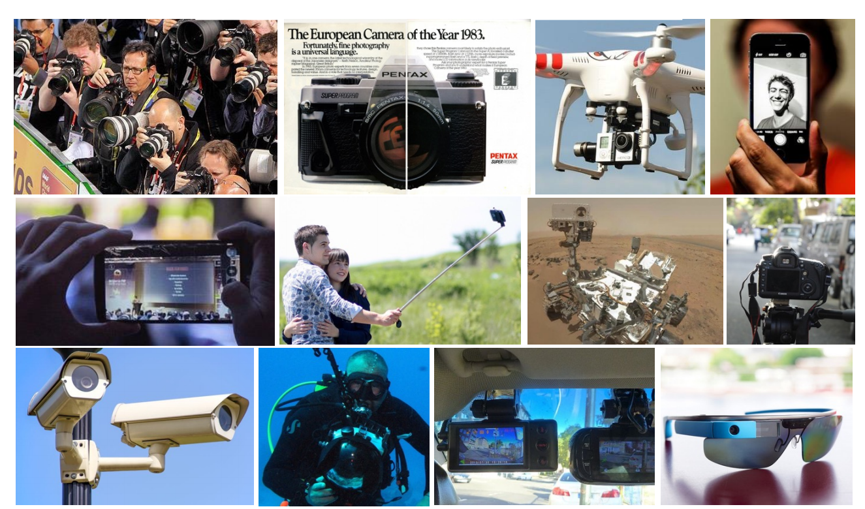
Visual data for Machine Vision

Slide 7
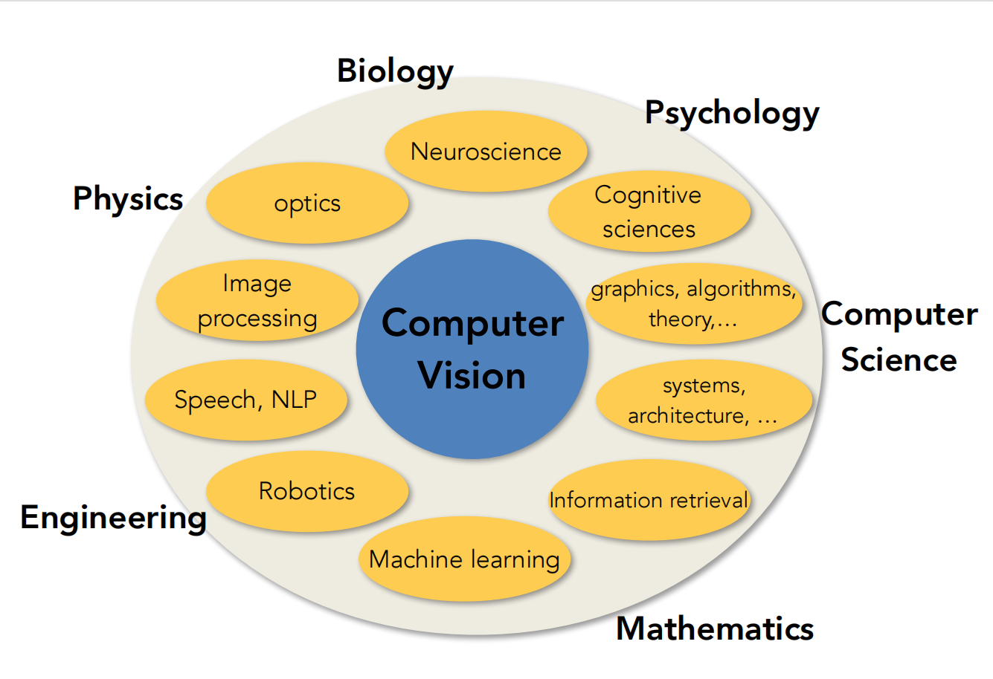
Machine Vision Applicationa Domain

Slide 8
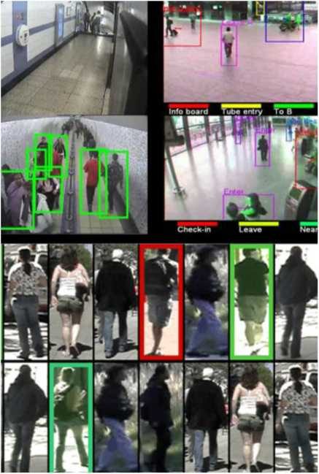
Applications of vision
Robotics: self-localization, map building, autonomous navigation Surveillance: “anomalous" event detection Biometrics: (face/identity recognition)
Human-machine interface:
natural interaction, video games!

Slide 9
Applications of vision
1. Smart rooms: assistance to elderly people
2. Entertainment industry: augmented reality (AR), special effects.
3. Military applications
4. Target tracking
5. Medical imaging

Slide 10
Key problems of Machine vision
Images are very high dimensional data: eg. 100 x 100 image represents 10⁴ dimensional vector of values.
Two dimensional image do not capture 3D structural information about the scene.
Quality of image is highly dependent on the imaging sensor
There is always a lot of background (useless) information.

Slide 11
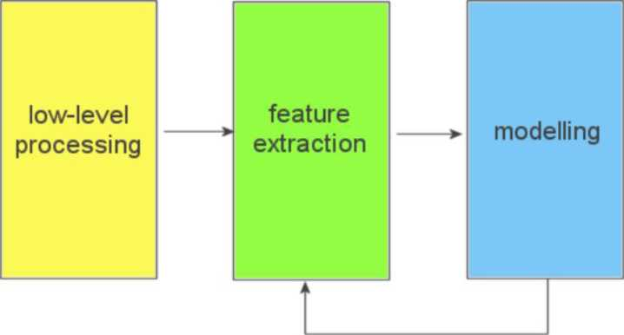
Structure of a vision system
machine vision system is typically composed by a number of cascade blocks
decision/
classification/
estimation
Block diagram

Slide 12
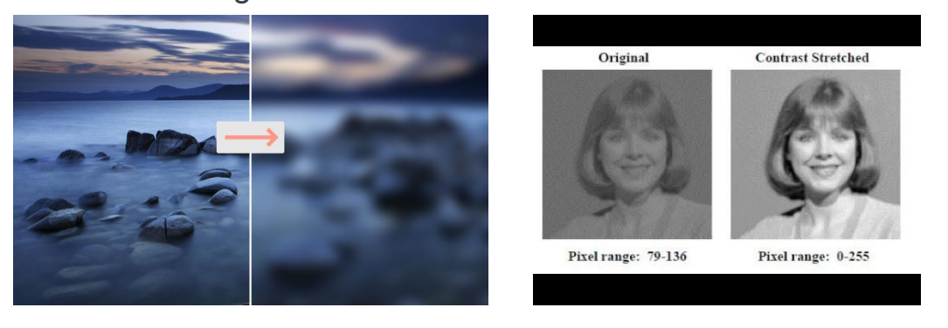
Structure of a vision system
First block: low level image processing designed to improve image quality or remove artifact, also known as preprocessing, e.g. gaussian blurring and contrast stretching

Slide 13
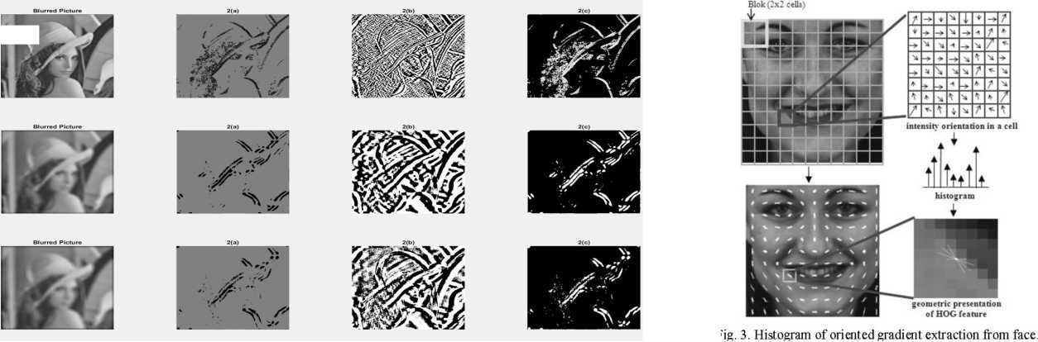
Structure of a vision system
Second block: features extraction is process of extracting relevant information from the image, eg. edge detection and Histogram of oriented gradients (HOG)

Slide 14
Structure of a vision system
Third block: It a model that takes in the extracted features at models their relationship for the task at hand. SVM, decision tree, neural network etc.
Final goal:
• decision/action
• classification/recognition
• estimation/reconstruction

Slide 15
Structure of a vision system
making decisions
example granting access to a person after face recognition
classifying the input images/videos
example: gesture recognition in human-machine interfaces
estimating a quantity of interest
example: estimating the depth of each point in the scene
estimating the pose of a moving object

Slide 16
Structure of a vision system
making decisions
example granting access to a person after face recognition
classifying the input images/videos
example: gesture recognition in human-machine interfaces
estimating a quantity of interest
example: estimating the depth of each point in the scene
estimating the pose of a moving object

Slide 17
Low level feature extraction
Images are complex descriptions of external world often more handy to extract some sort of salient measurements or features from an image.
Features are later used to make inferences, decisions, or estimations on the action to take or the structure of the outside world
Features come in many different forms:
points of interest
Edges, contours
Textures

Slide 18
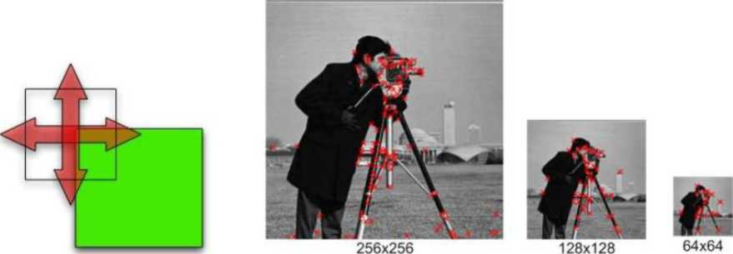
Interest points
Images are complex descriptions of external world, lots
of variability determined by nuisance factors
Need to find areas where the relevant information is
contained
Interest points: local neighborhood rich of information, stable with respect to changes of view/illumination

Slide 19
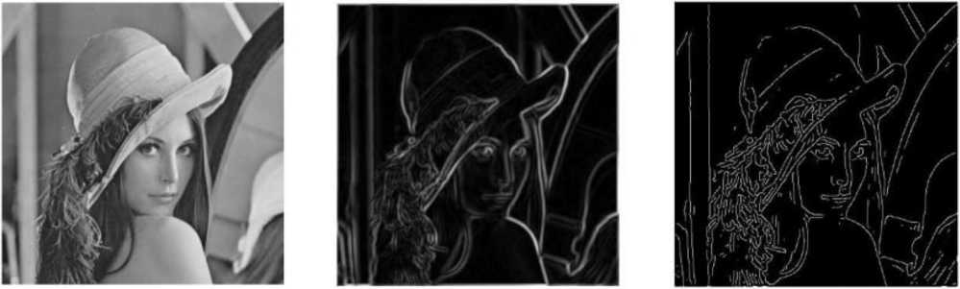
Edge detection
Edge is the region of the image which has very high gradient value in either of horizontal of vertical directions.
Gradient represents the change in pixel value in reference to its surrounding.

Slide 20
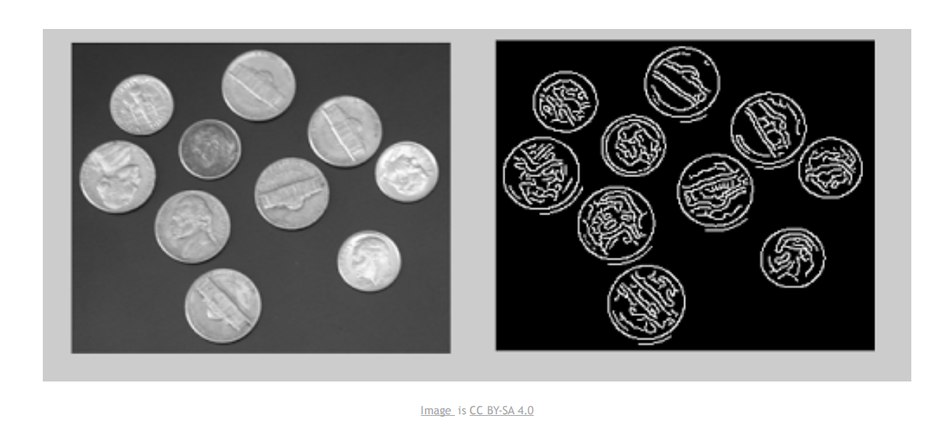
Edge detection
Edges are normally related either to variations in the appearance of the viewed object(s) (e.g. trees, persons, cars, etc) or to boundaries between separate objects

Slide 21
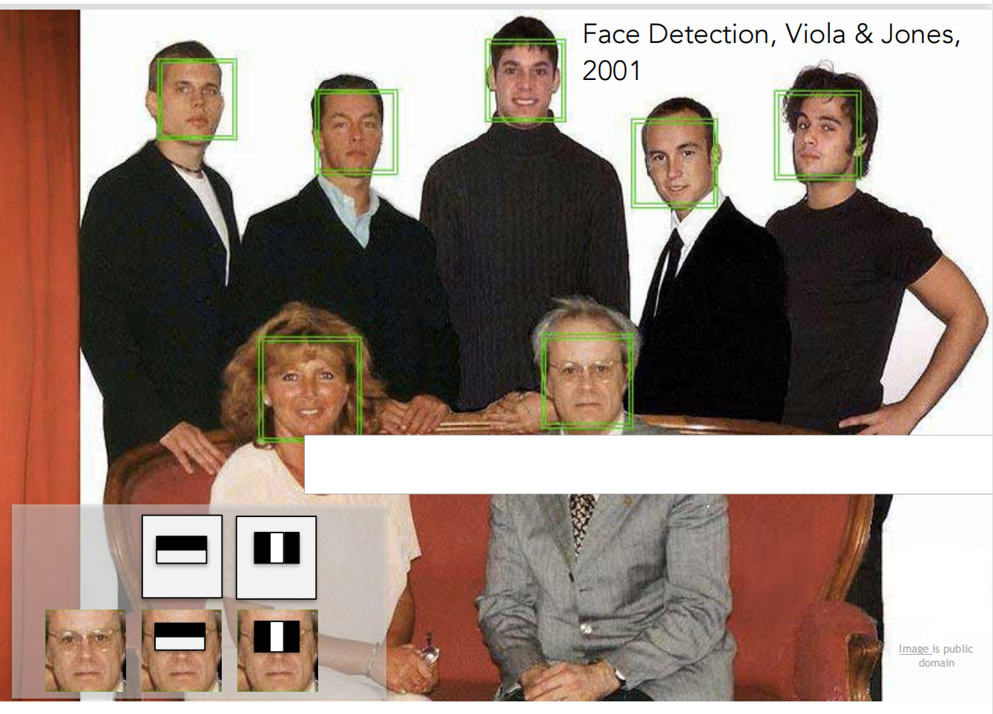
Face detection

Slide 22
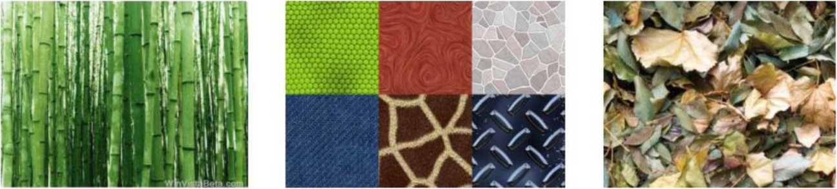
Textures
Textures: areas of an image in which a certain “appearance pattern" is present.
Texture classification is used for object recognition
Texture information can be used for synthesis 3D rendering.

Slide 23
Image and video compression
Images and videos come in lots of different formats: why?
Limited transmission capacity and storage space.
Compression is used to reduce the amount of memory
used to store the image or video.
1. Lossy compression:
Discrete Cosine Transform,
Discrete Wavelet Transform
2. Lossless compression:
Run Length Encoding
Examples: TIFF, JPG (images), MPEG (videos)

Slide 24
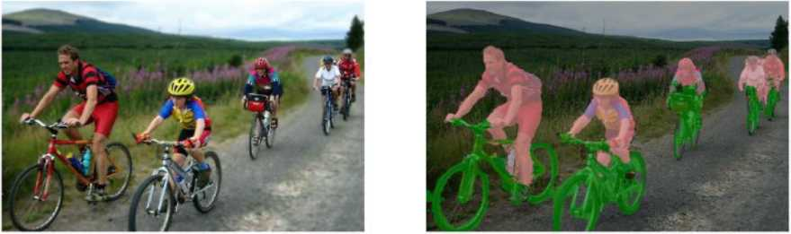
Image segmentation
Image segmentation is process of labeling each pixel in image to a predefined category.
Segmentation can be based on difference of brightness, color, texture, motion., (often two regions: foreground and background)
Original image (hover to highlight segmented parts! Semantic segmentation
Objects appearing n the image
B*cyde
mam

Slide 25
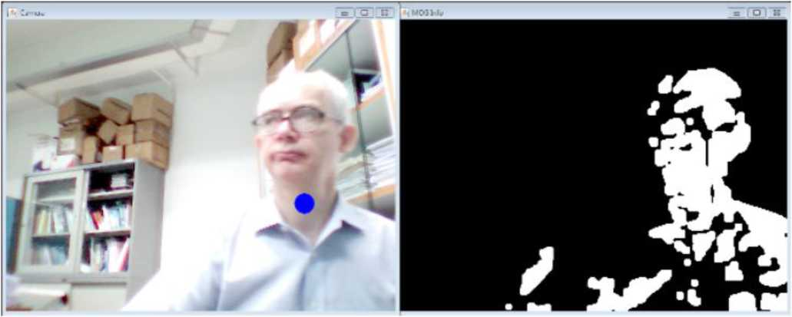
OXFORD
BROOKES
Background segmentation
UNIVERSITY
For a lot of applications we need to know what is foreground and what is background.
Background segmentation utilizes the property of motion in the video to segment two parts.

Slide 26
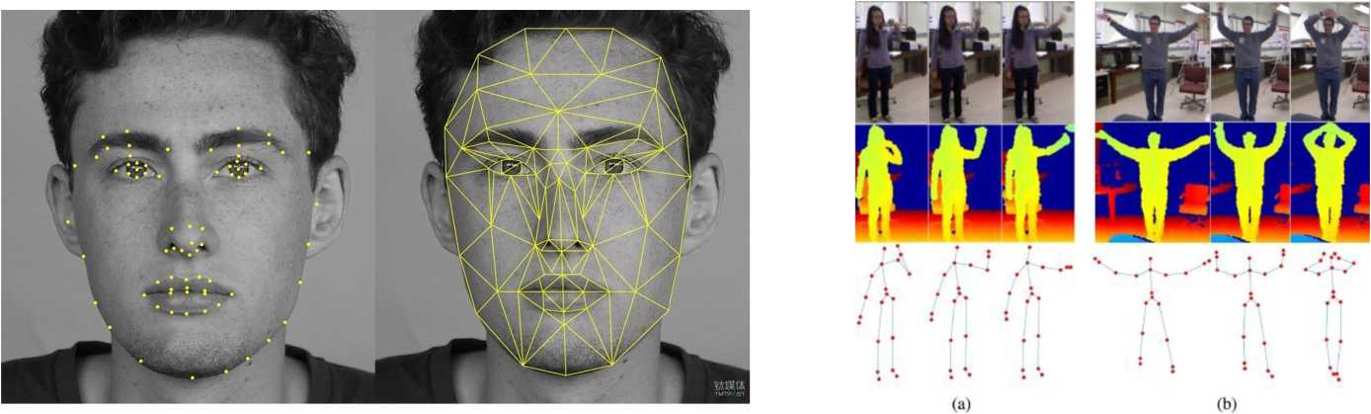
Recognition
Recognition involves identifying the category of the object present in image.
Face recognition
Object recognition
Action recognition (uses sequence generally)

Slide 27
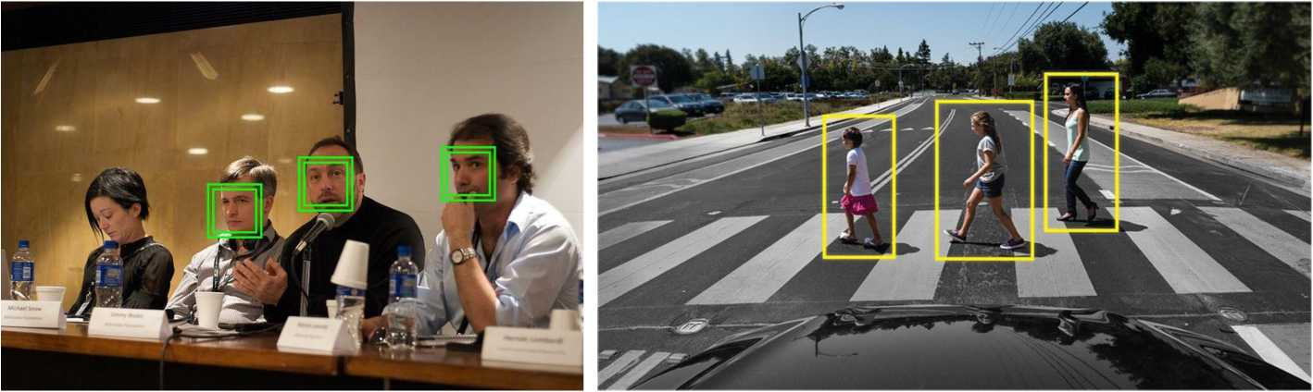
Detection
Detection involves identifying the location of objects in the image.
Face detection
Pedestrian detection

Slide 28
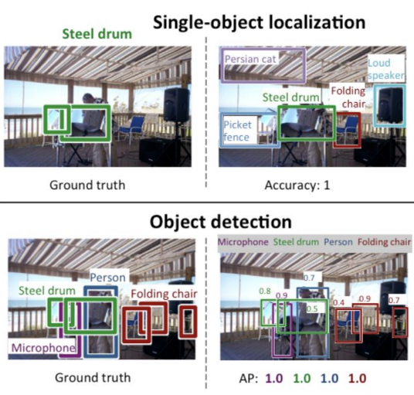
Detection
Object detection
Object Localization: does not provide category of the objects.

Slide 29
OXFORD
BROOKES
Segmentation
UNIVERSITY
Semantic segmentation: process of classifying each pixel belonging to a particular label. It doesn't differentiate across different instances of the same object.
Instance segmentation: It gives a unique label to every instance of a particular object in the image.
Panoptic segmentation: it combines semantic segmentation and instance segmentation. Has two components: background and objects

Slide 30
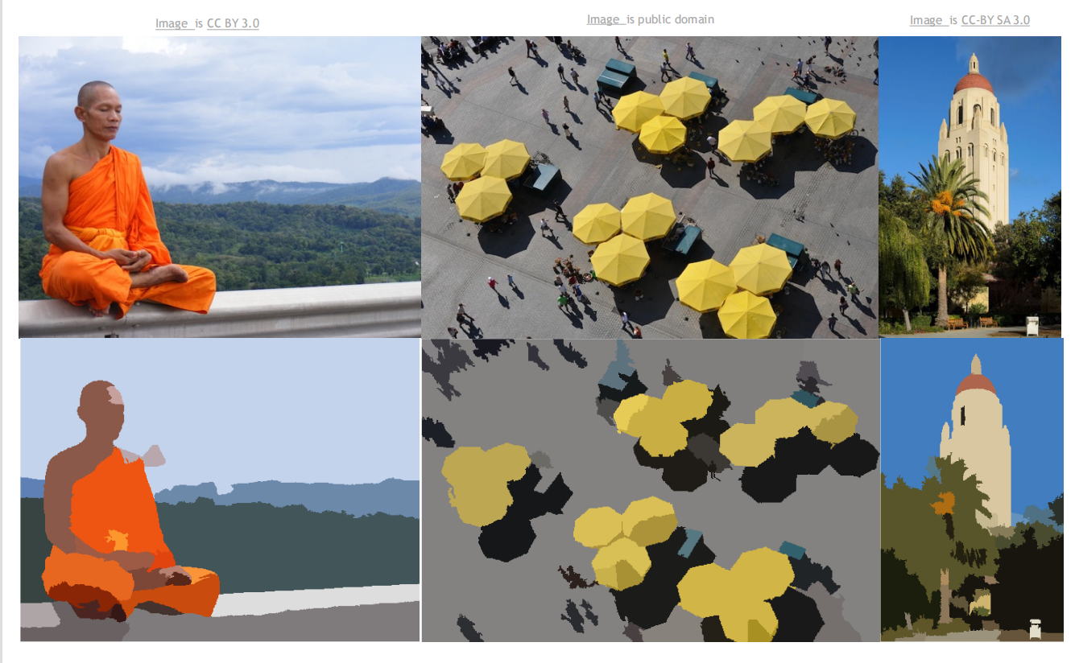
OXFORD
BROOKES
Segmentation
UNIVERSITY

Slide 31
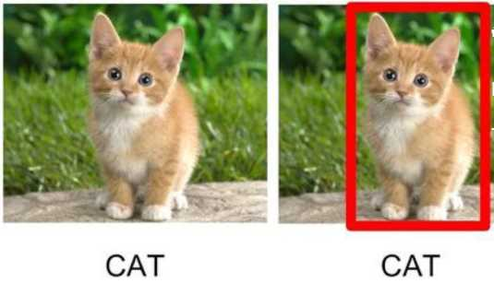
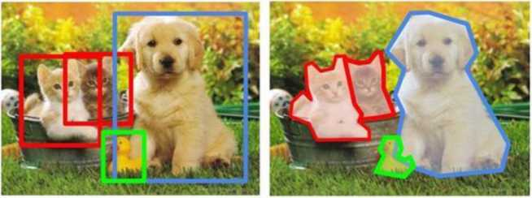
Different Computer Vision tasks
CAT, DOG, DUCK
CAT, DOG, DUCK
Single object
Multiple objects

Slide 32
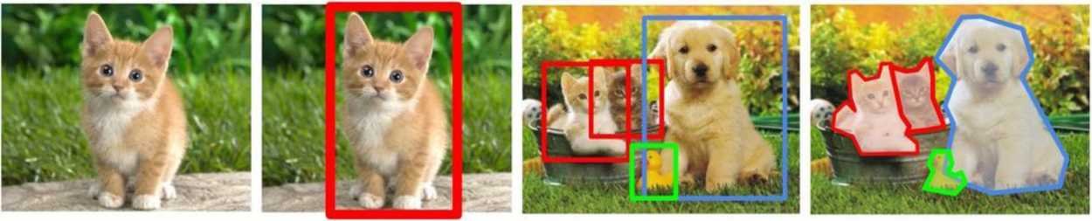
Different Computer Vision tasks
Classification + Localization
Object Detection
Instance
Segmentation
Classification
CAT
CAT
CAT, DOG, DUCK
CAT, DOG, DUCK
Single object
Multiple objects

Slide 33
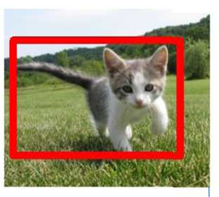
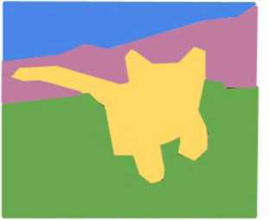
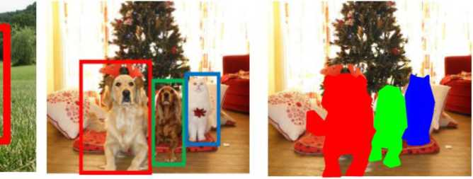
Different Computer Vision tasks
GRASS, CAT, TREE, SKY
CAT
DOG, DOG, CAT
DOG, DOG, CAT
Multiple Object
Single Object
No objects, just pixels

Slide 34
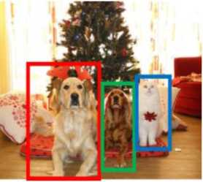
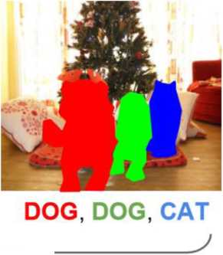
Different Computer Vision tasks
Classification + Localization
Semantic
Segmentation
Object
Detection
Instance
Segmentation
GRASS, CAT, TREE, SKY
CAT
DOG, DOG, CAT
Multiple Object
Single Object
No objects, just pixels

Slide 35
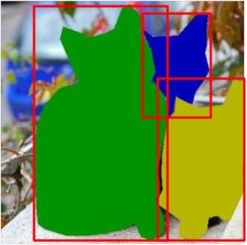
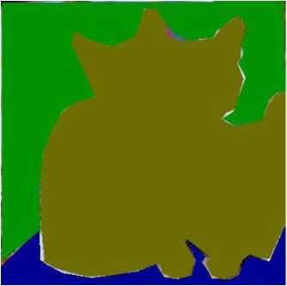
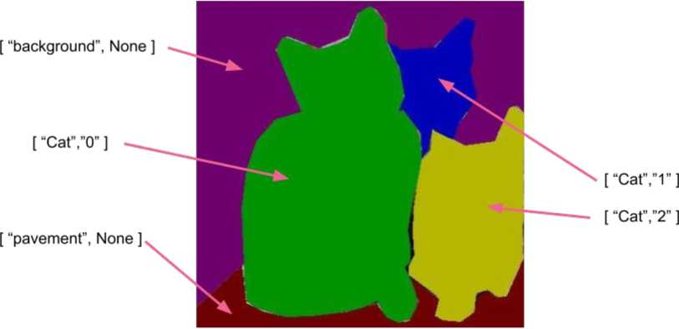
Panoptic segmentation
Semantic
segmentation
Instance
segmentation
Panoptic
segmentation

Slide 36
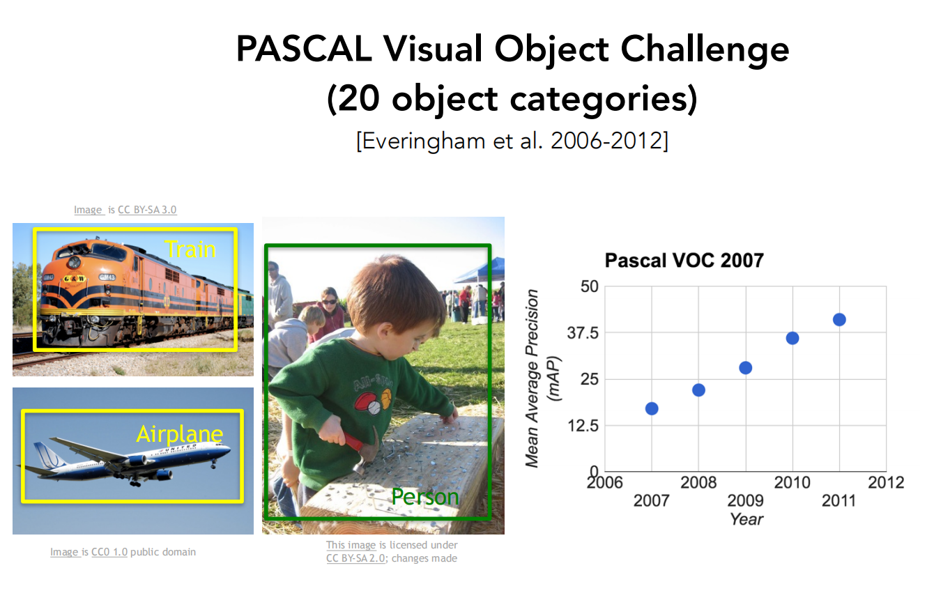

Slide 37
Basic Image Processing

Slide 38
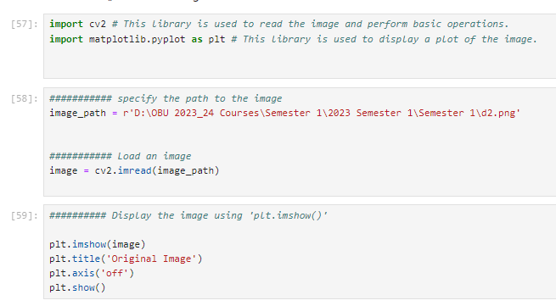
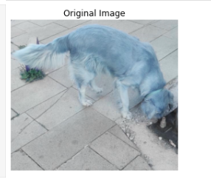
Read and Display Image
Output

Slide 39
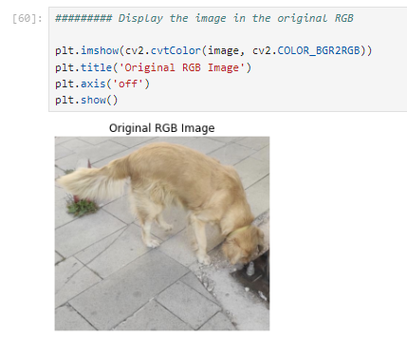
Read and Display Image
Output

Slide 40
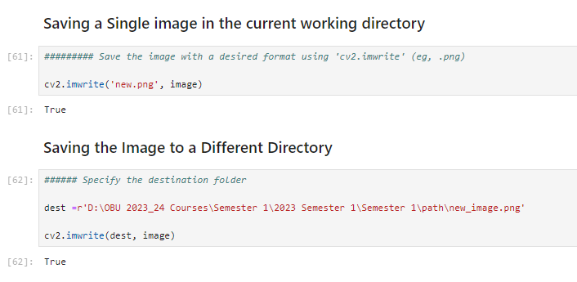
Saving The Output Image

Slide 41
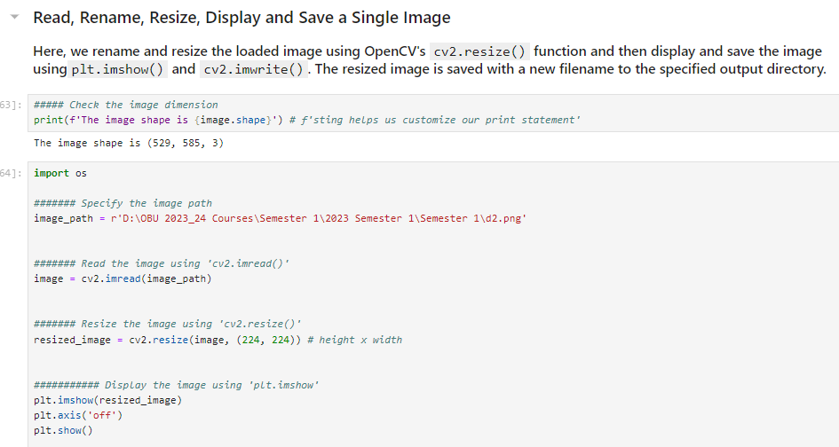
Image Manipulation

Slide 42
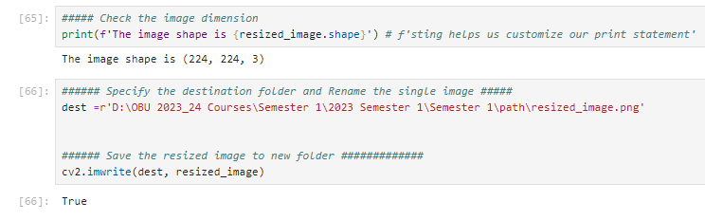
Image Manipulation

Slide 43
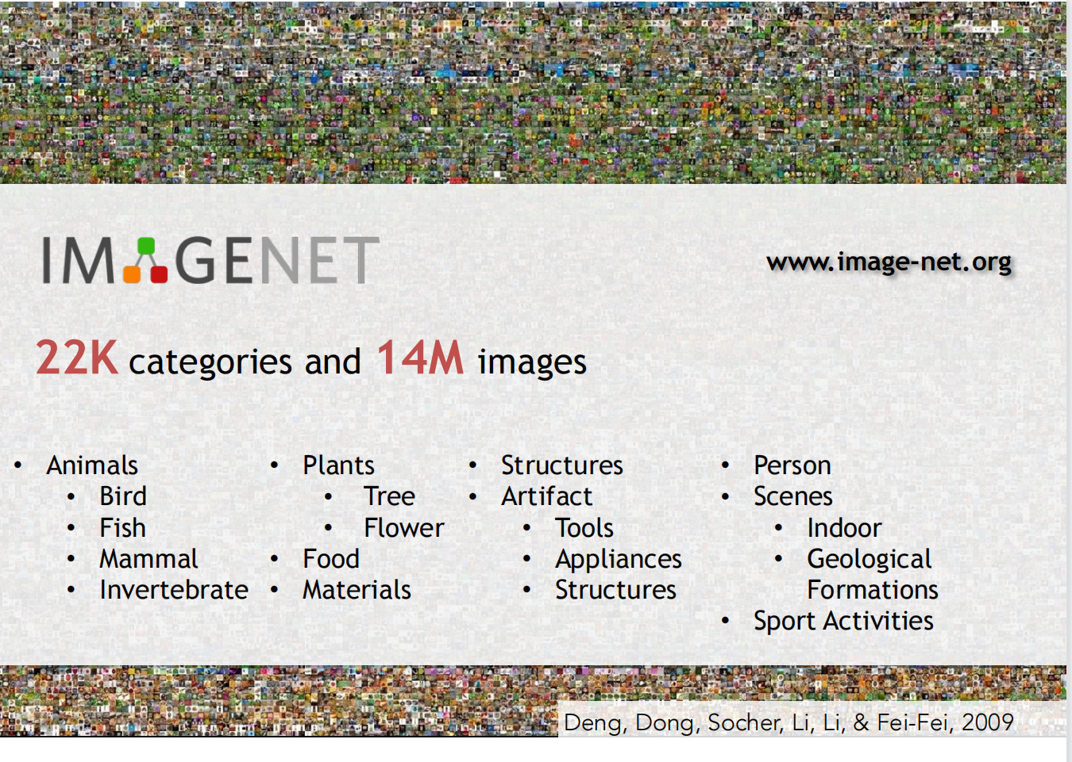

Slide 44
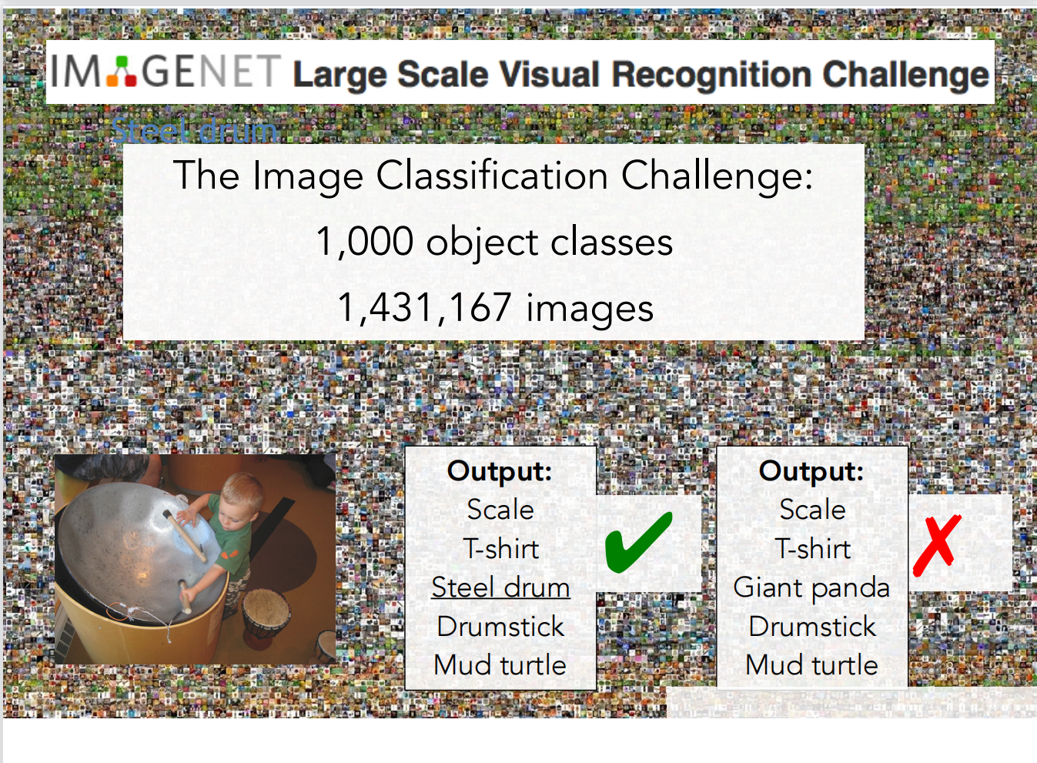

Slide 45
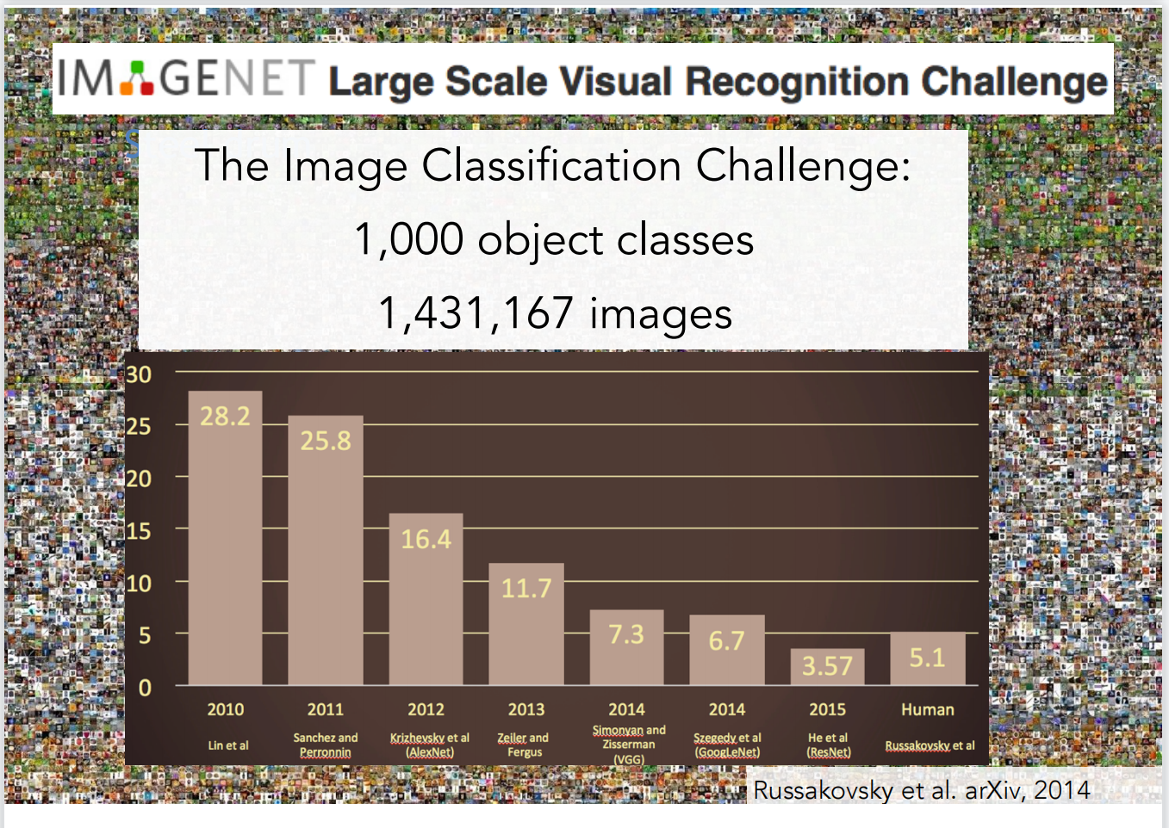

Slide 46
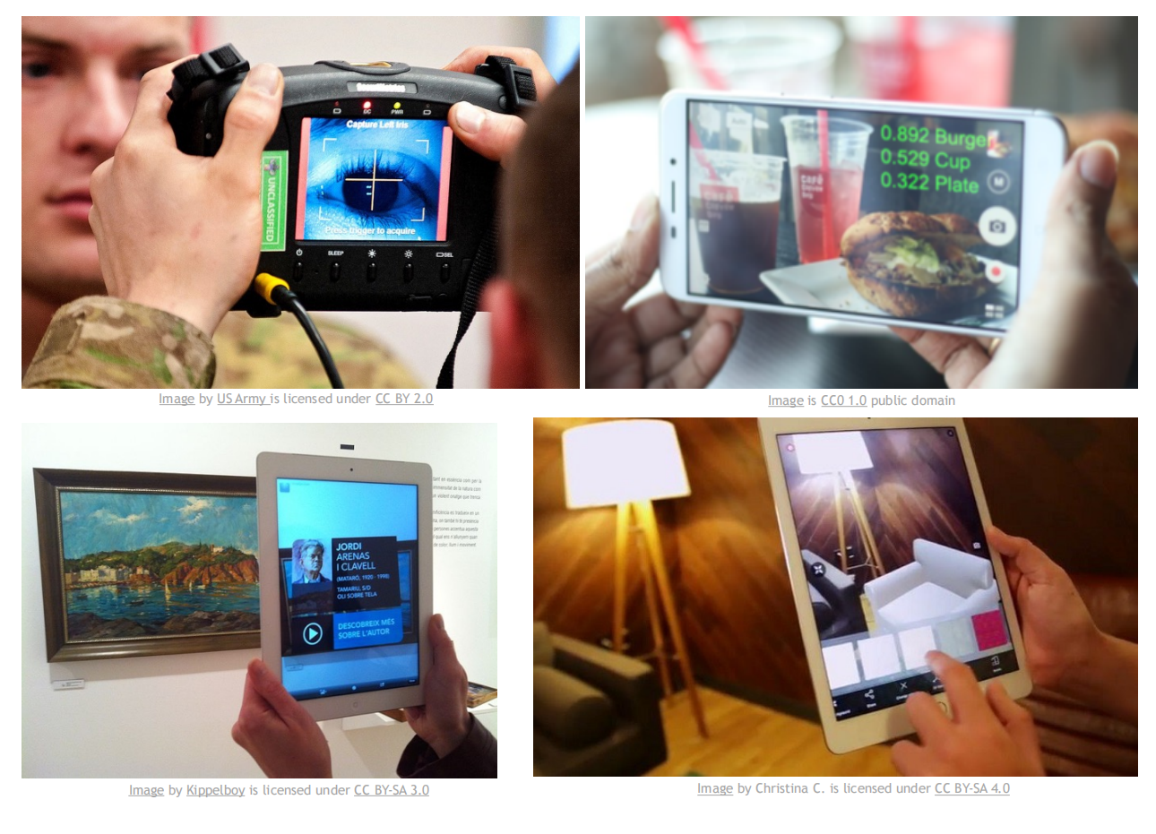
Computer Vision in Real-World

Slide 47
Computer Vision in Real-World

Slide 48
There is a number of visual recognition problems that are related to image classification, such as object detection, image captioning

Slide 49
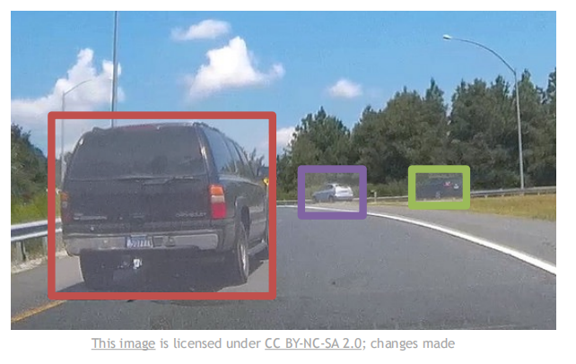
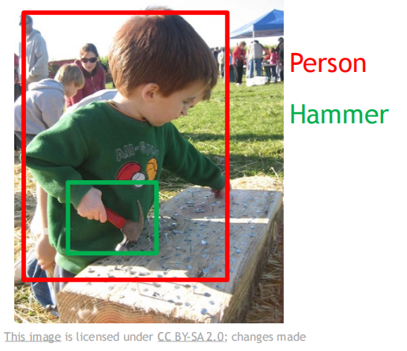
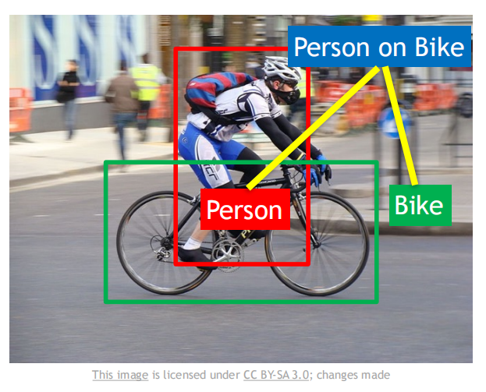
Object detection
Action classification
Image captioning

Slide 50
Convolutional neural Network (CNN) have become an important tool for object recognition

Slide 51
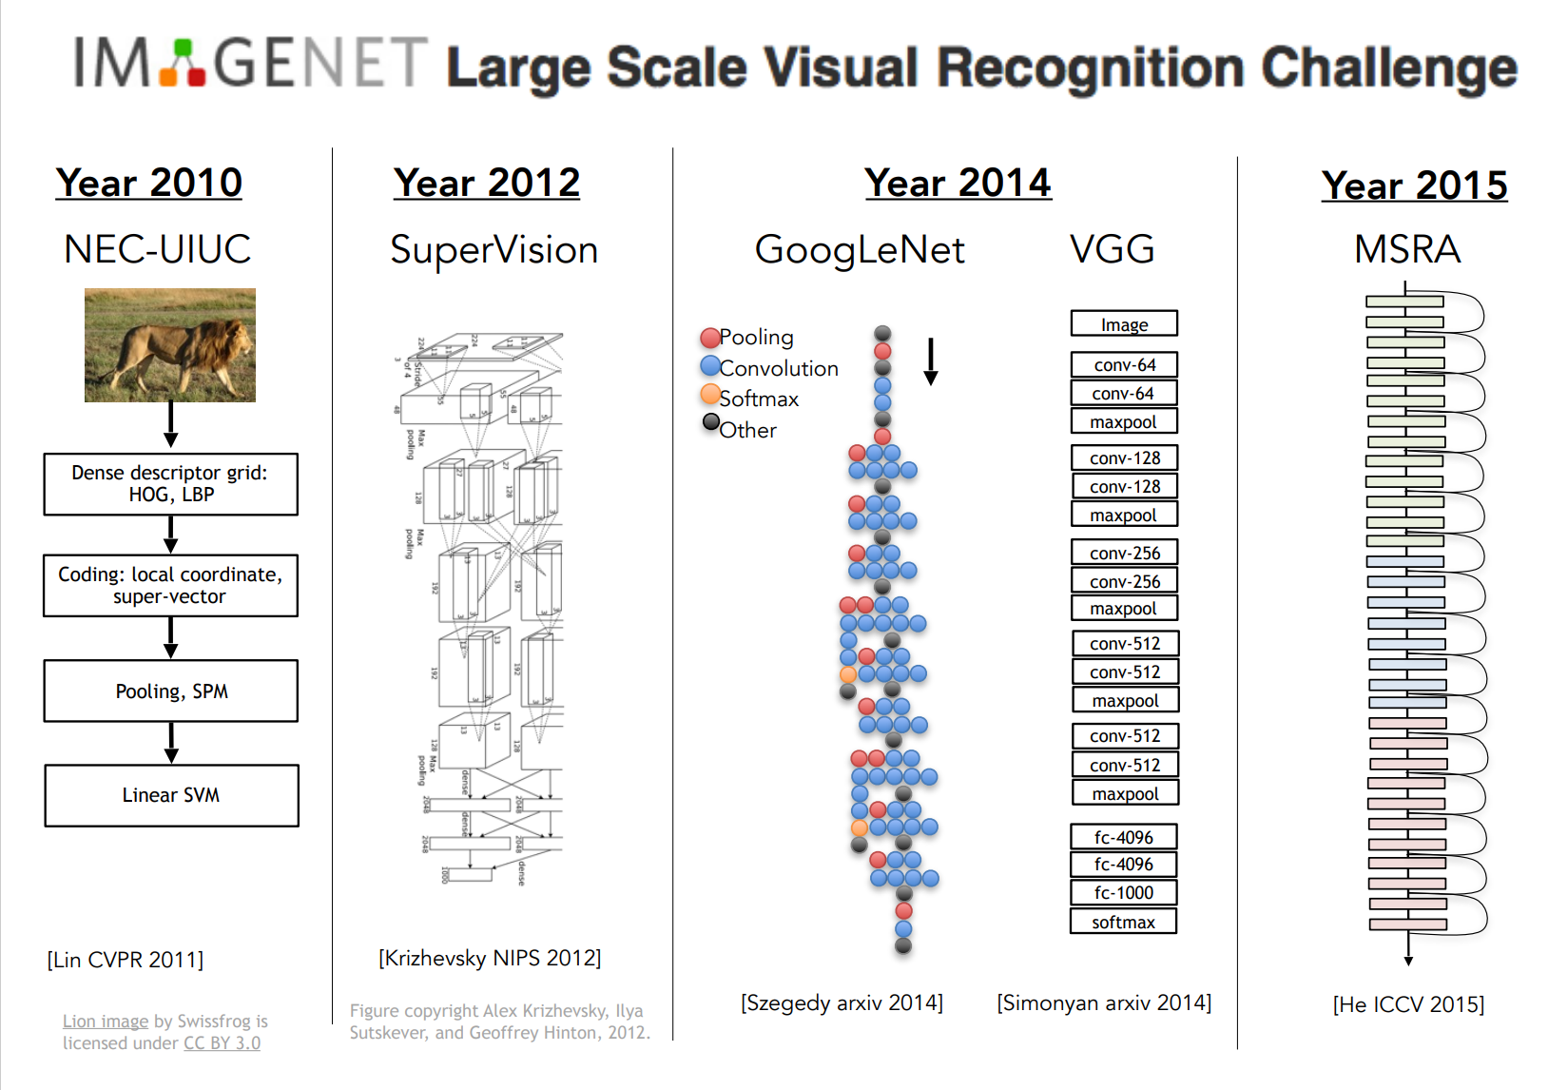

Slide 52
Convolutional neural Network (CNN) were not invented overnight

Slide 53
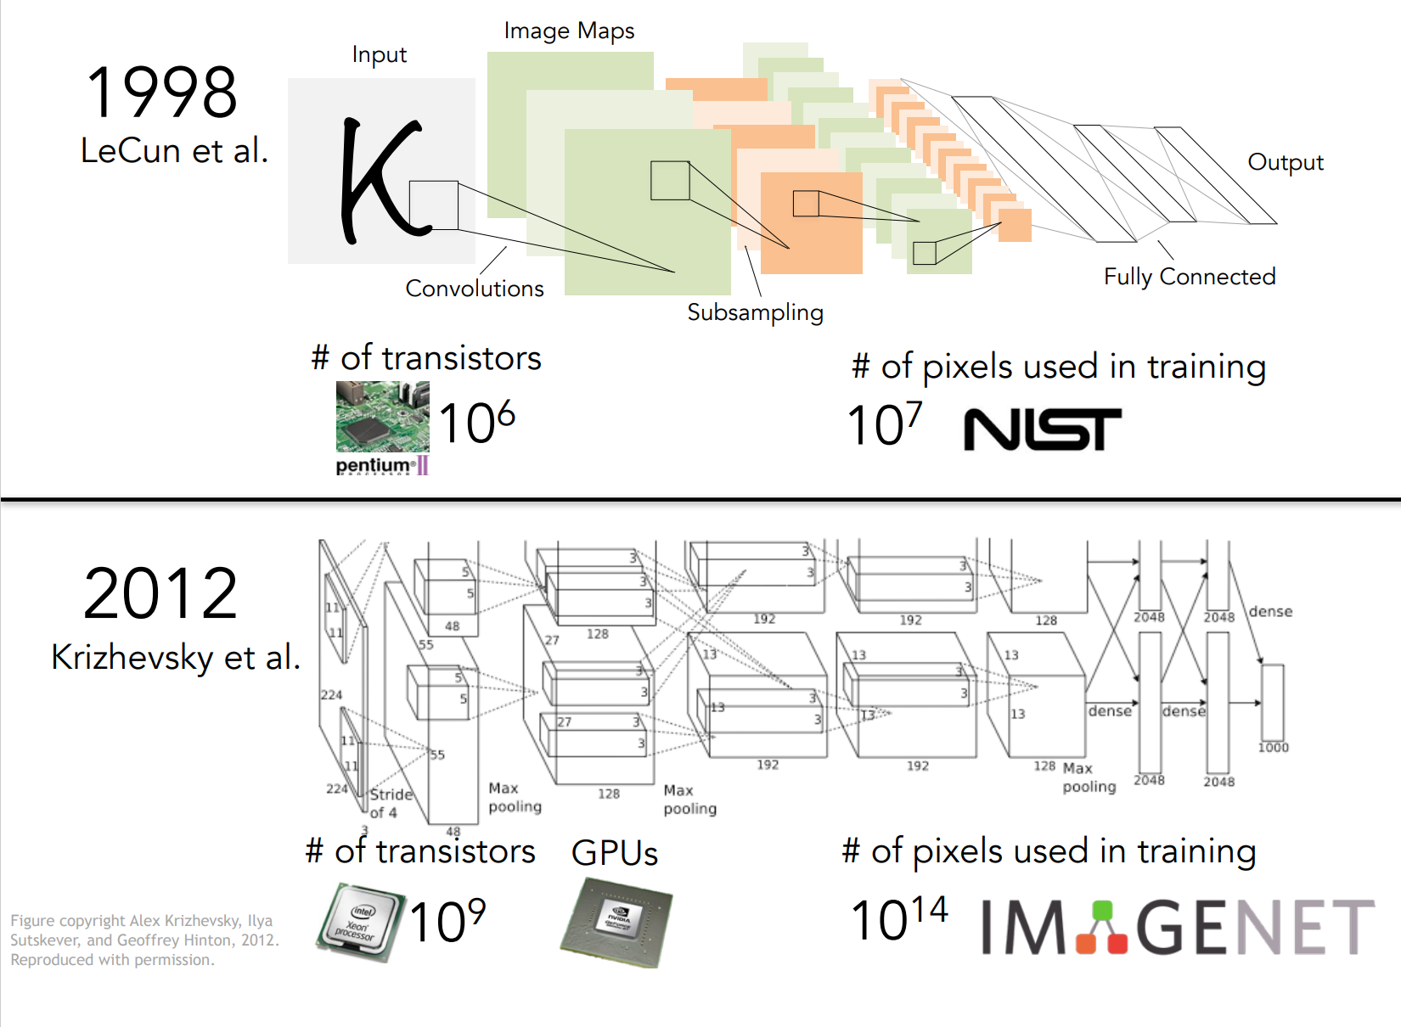

Slide 54
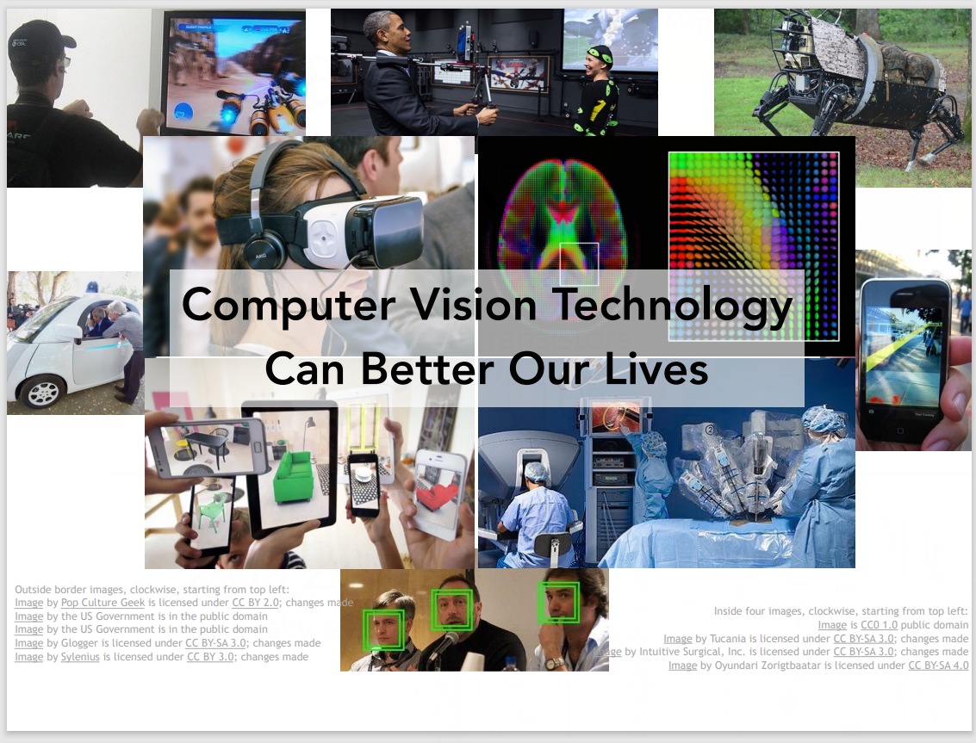

Slide 55
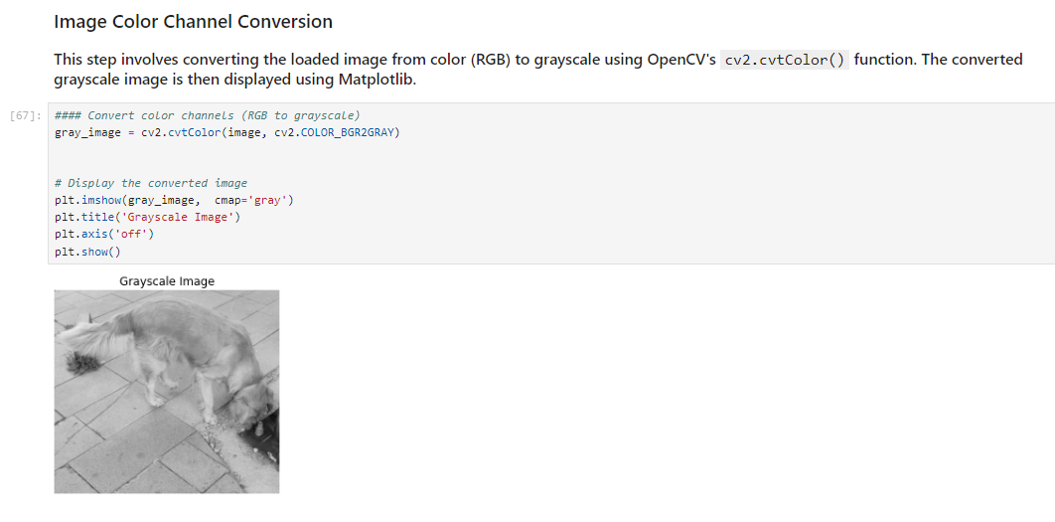
Image Preprocessing

Slide 56
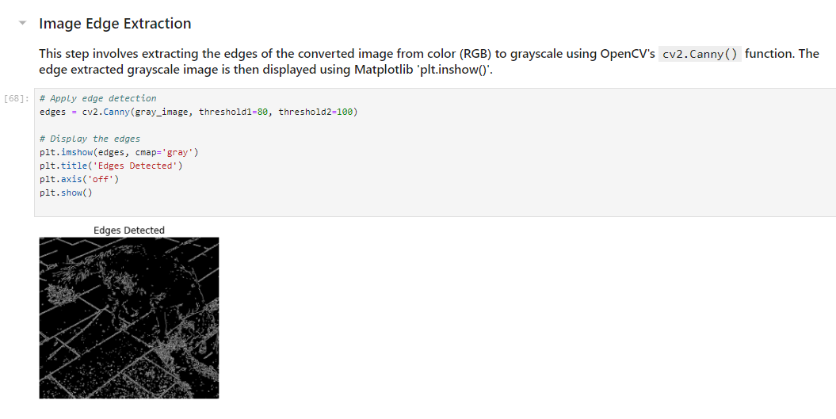
Image Preprocessing

Slide 57
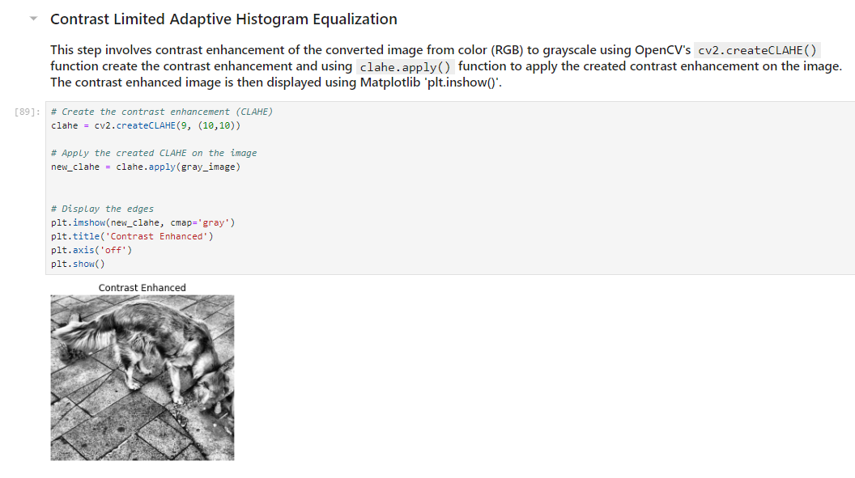
Image Preprocessing

Slide 58
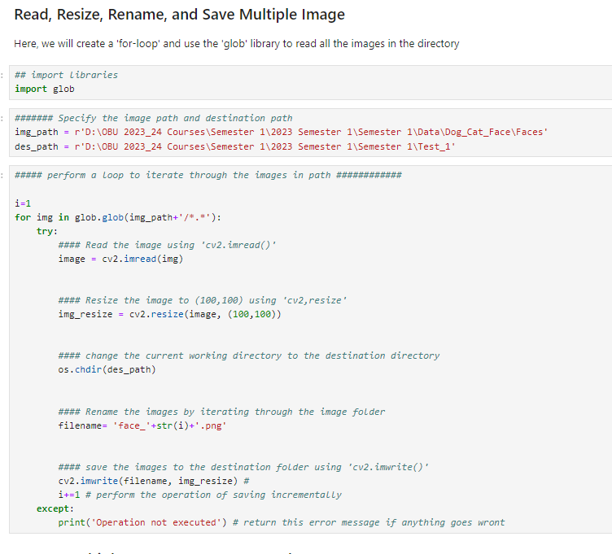
Image Preprocessing

Slide 59
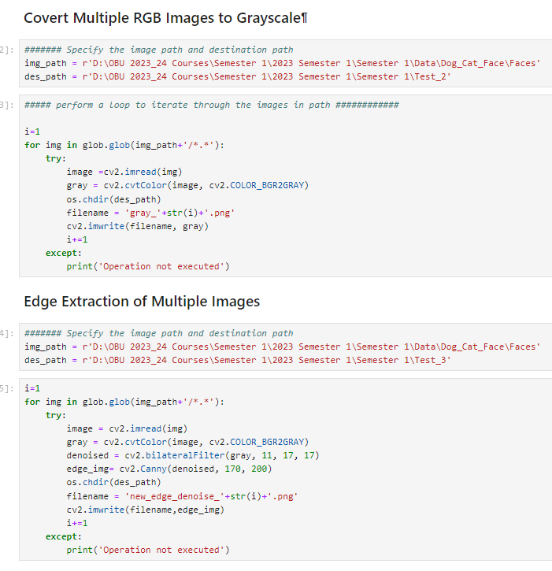
Image Preprocessing

Slide 60

Image Preprocessing

Slide 61
The End!

